Slide 1
CS118 – Programming Fundamentals
Lecture # 19
Monday, October 28, 2019
FALL 2019
FAST – NUCES, Faisalabad Campus
Course Instructor:
Ebad Majeed
Slides Credit:
Rizwan Ul Haq

Slide 2
Flow of Execution
Execution always begins at the first statement in the function main
Other functions are executed only when they are called
Function prototypes appear before any function definition
The compiler translates these first
The compiler can then correctly translate a function call

Slide 3
Flow of Execution (cont'd.)
A function call results in transfer of control to the first statement in the body of the called function
After the last statement of a function is executed, control is passed back to the point immediately following the function call
A value-returning function returns a value
After executing the function the returned value replaces the function call statement

Slide 4
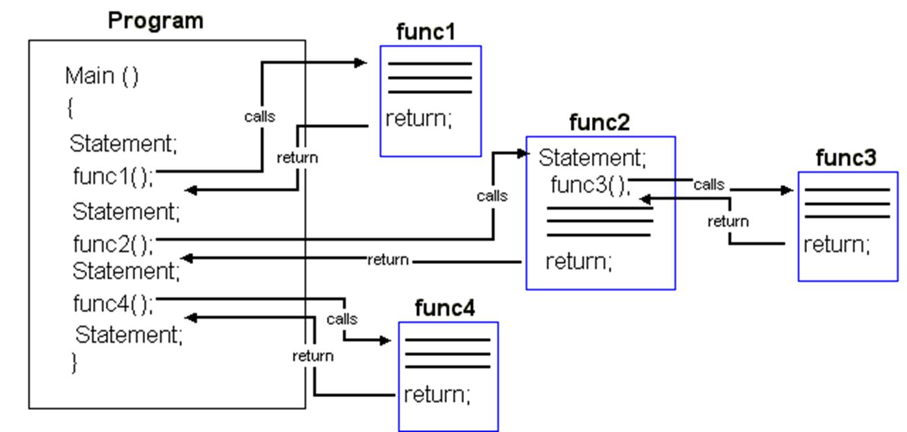
Conti…

Slide 5
void Functions
void functions and value-returning functions have similar structures
Both have a heading part and a statement part
User-defined void functions can be placed either before or after the function main
If user-defined void functions are placed after the function main
The function prototype must be placed before the function main

Slide 6
void Functions (cont'd.)
A void function does not have a return type
return statement without any value is typically used to exit the function early.
It can be used in void for early termination
Formal parameters are optional
A call to a void function is a stand-alone statement

Slide 7

void Functions (cont'd.)
Function definition syntax:
Formal parameter list syntax:

Slide 8

Void Functions (cont'd.)
Function call syntax:
Actual parameter list syntax:

Slide 9
void Functions (cont'd.)
Value parameter: A formal parameter that receives a copy of the content of corresponding actual parameter
Reference parameter: A formal parameter that receives the location (memory address) of the corresponding actual parameter

Slide 10
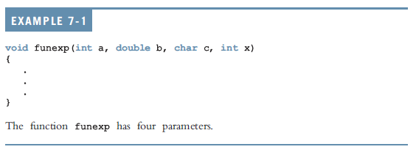
void Functions (cont'd.)

Slide 11
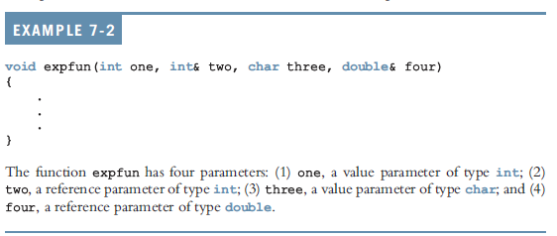
void Functions (cont'd.)

Slide 12
value Parameters
If a formal parameter is a value parameter
The value of the corresponding actual parameter is copied into it
The value parameter has its own copy of the data
During program execution
The value parameter manipulates the data stored in its own memory space

Slide 13
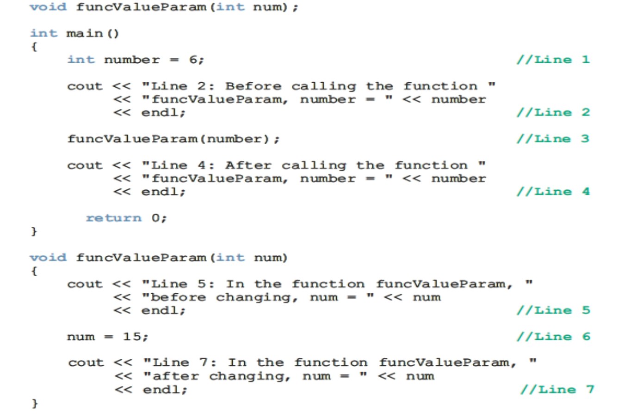
Example

Slide 14
Reference Variables as Parameters
If a formal parameter is a reference parameter
It receives the memory address of the corresponding actual parameter
A reference parameter stores the address of the corresponding actual parameter
During program execution to manipulate data
The address stored in the reference parameter directs it to the memory space of the corresponding actual parameter

Slide 15
Reference Variables Benefits
Reference parameters can:
Pass one or more values from a function
Change the value of the actual parameter
Reference parameters are useful in three situations:
Returning more than one value
Changing the actual parameter
When passing the address would save memory space and time

Slide 16
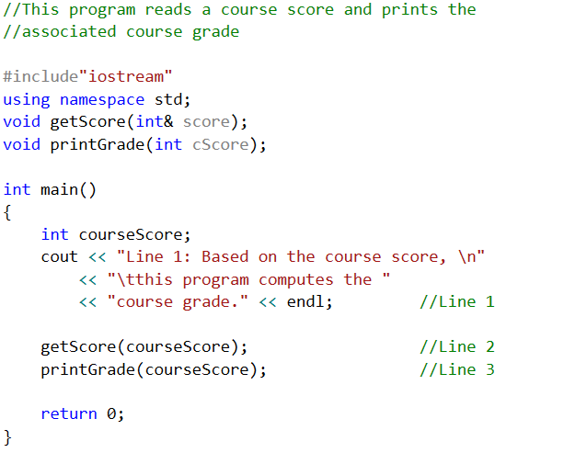
Example 7-5: Calculate Grade

Slide 17
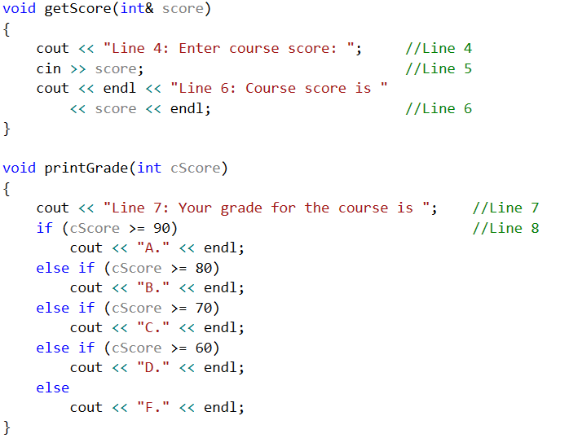
Example 7-5: Calculate Grade (cont'd.)

Slide 18
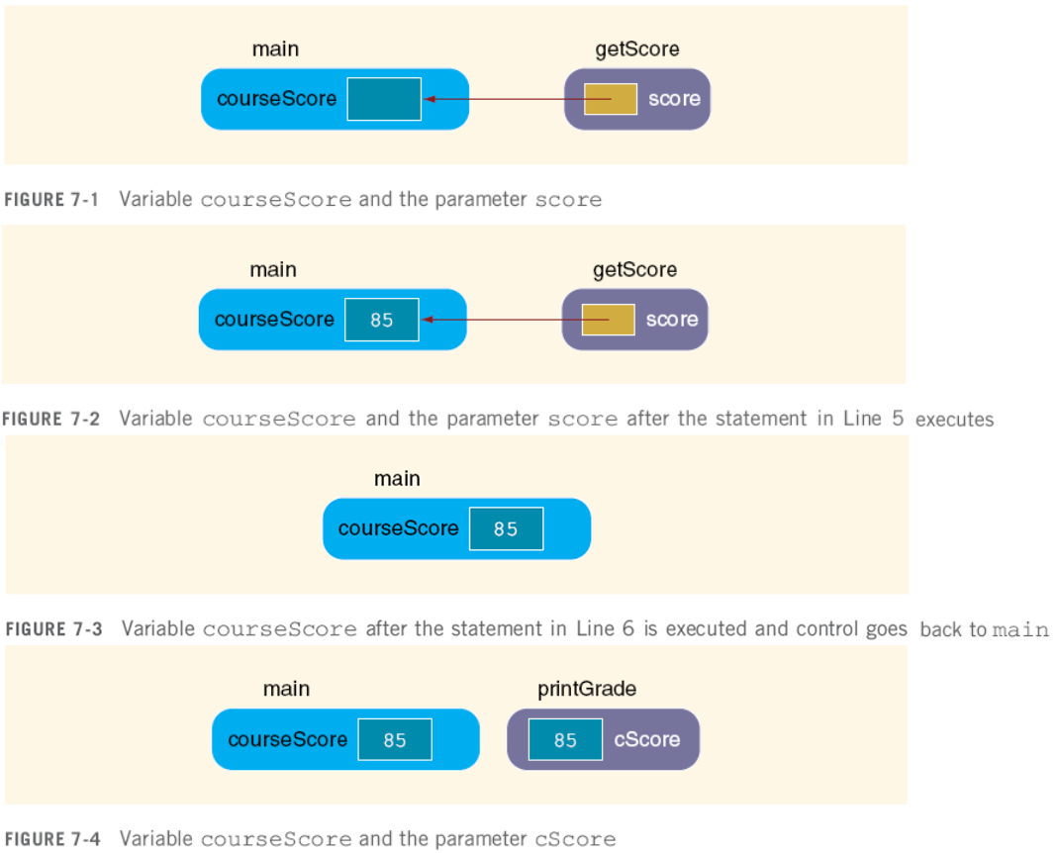
Example 7-5: Calculate Grade (cont'd.)

Slide 19
Value and Reference Parameters and Memory Allocation
When a function is called
Memory for its formal parameters and variables declared in the body of the function (called local variables) is allocated in the function data area
In the case of a value parameter
The value of the actual parameter is copied into the memory cell of its corresponding formal parameter

Slide 20
Value and Reference Parameters and Memory Allocation (cont'd.)
In the case of a reference parameter
The address of the actual parameter passes to the formal parameter
Content of formal parameter is an address
During execution, changes made by the formal parameter permanently change the value of the actual parameter

Slide 21
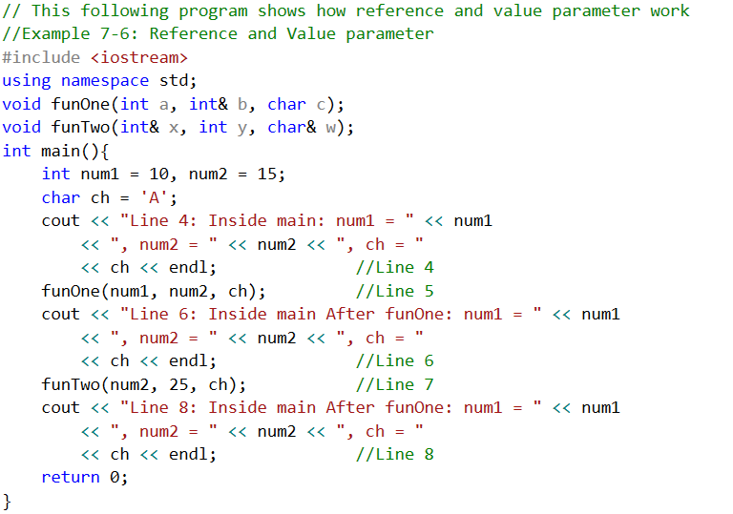
Value and Reference Parameters and Memory Allocation (cont'd.)

Slide 22
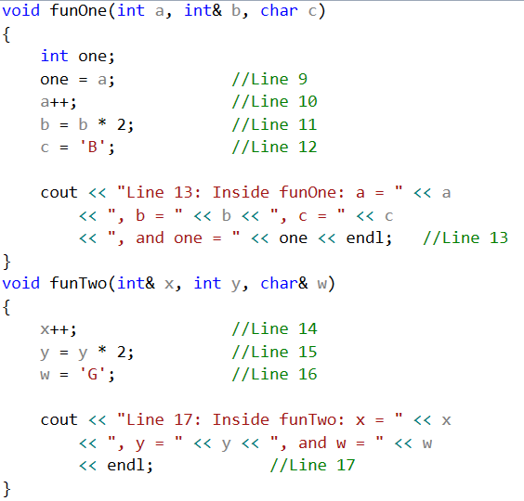
Value and Reference Parameters and Memory Allocation (cont'd.)

Slide 23
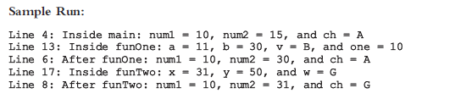
Value and Reference Parameters and Memory Allocation (cont'd.)

Slide 24
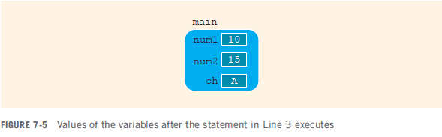
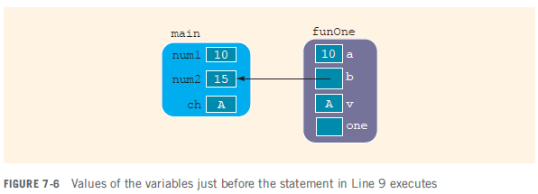
Value and Reference Parameters and Memory Allocation (cont'd.)

Slide 25
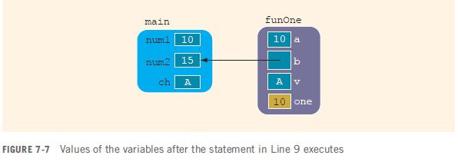
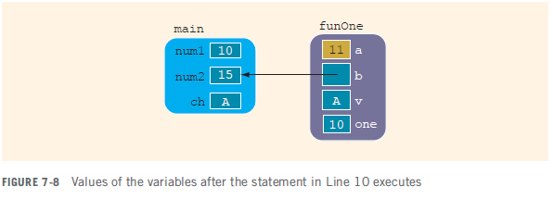
Value and Reference Parameters and Memory Allocation (cont'd.)

Slide 26
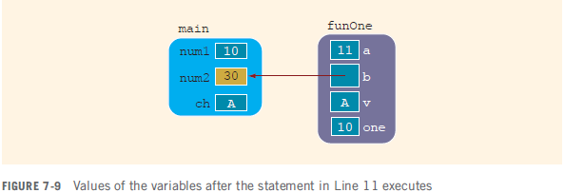
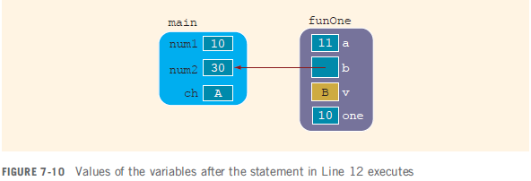
Value and Reference Parameters and Memory Allocation (cont'd.)

Slide 27
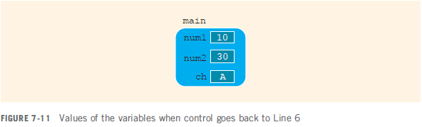
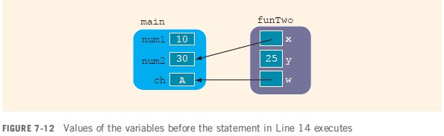
Value and Reference Parameters and Memory Allocation (cont'd.)

Slide 28
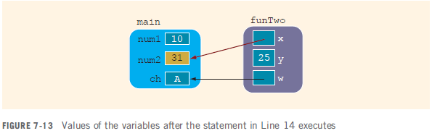
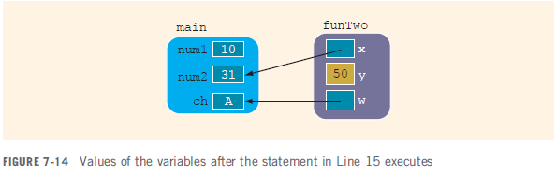
Value and Reference Parameters and Memory Allocation (cont'd.)

Slide 29
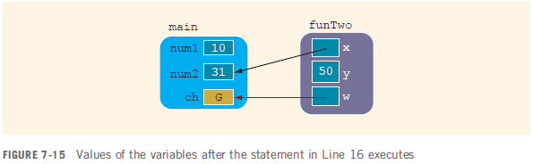
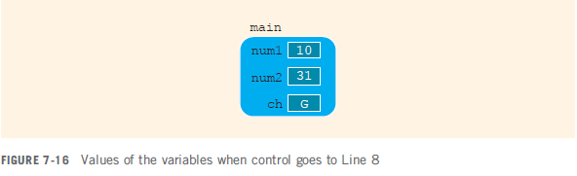
Value and Reference Parameters and Memory Allocation (cont'd.)

Slide 30
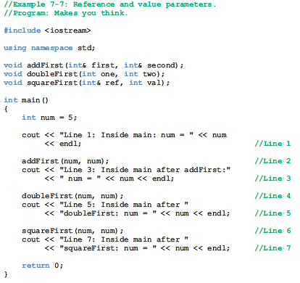

Slide 31
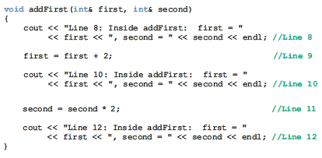
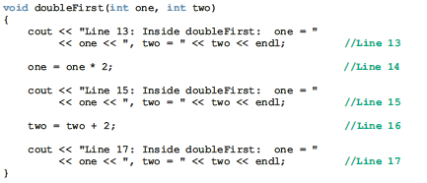

Slide 32
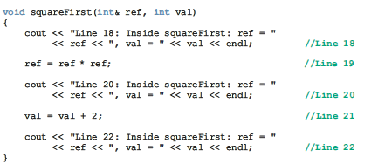
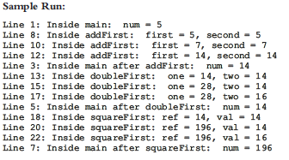

Slide 33
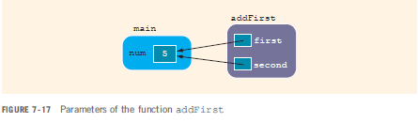
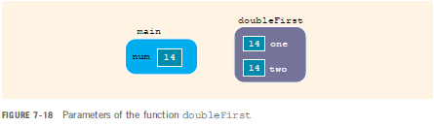
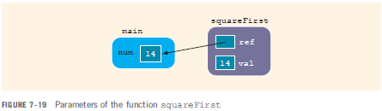

Slide 34
Reference Parameters and Value-Returning Functions
You can also use reference parameters in a value-returning function
Not recommended
By definition, a value-returning function returns a single value
This value is returned via the return statement
If a function needs to return more than one value, you should change it to a void function and use the appropriate reference parameters to return the values

Slide 35
Using Functions in a Menu-Driven Program
Functions can be used:
To implement user choices from menu
To implement general-purpose tasks
Higher-level functions can call general-purpose functions
This minimizes the total number of functions and speeds program development time

Slide 36
Questions

